Slide 1
Welcome to the Local Meeting
Date

Slide 2
Orientating to Zoom
Reactions
Start Video
Open the chat box
Mute/unmute yourself
View participants

Slide 3
Change display names
1
2
3
Notes:
Change participants’ names by opening the Participants List. Beside the Participant’s name, you can click on “More” and you will be given the option the “Rename”
For participants phoning-in: They will not be able to change their display names for phone participants. But you can change it similarly by selecting “More” beside their name in the Participants List

Slide 4
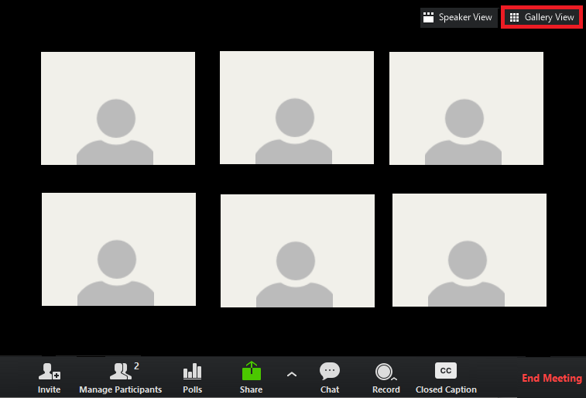
Add text
Switch to Gallery View to see everyone
Notes:
Change your meeting view in the upper right hand corner so that you can see as many people as possible.
This makes it easier for you to see any one who has raised their hands.

Slide 5
View Options
Display
You can use side by side mode to see both the screen share and the people
Notes:
THI
Side by side mode to see the chat and the participants

Slide 6
Welcome to the Local Meeting
Date

Slide 7
Land Acknowledgement:
As a social justice union, HEU has made a commitment to understand and implement recommendations made by Canada’s Truth and Reconciliation Commission. We recognize the history of colonization and the residential school system, and we’re committed to taking action that supports justice and reconciliation for Indigenous peoples. Becoming aware of the history and our own relationship with the land that we are living on is one piece of this important process.
Go to native-land.ca for territory

Slide 8
Local Meeting Agenda
Call to order
Roll Call of Officers
Equity Statement
Initiation of Members
Reading of Minutes
Correspondence
Treasurer’s Report
Trustees’ Report
Report of Delegates and Committees
Unfinished Business
Elections and Installations of Officers
New Business
Good and Welfare
Question Period

Slide 9
Equity Statement
Union solidarity is based on the principle that union members are equal and deserve mutual respect at all levels. Any behaviour that creates conflict prevents us from working together to strengthen our union.
We should never condone nor tolerate behaviour within our union that undermines the dignity or self-esteem of any individual or creates an intimidating, hostile or offensive environment.
HEU’s policies and practices must reflect our commitment to diversity, equity and inclusion.
Discriminatory speech or conduct based on Indigenous identity, sexism, racism, colonialism, homophobia, transphobia, ageism, and ableism have no place in our union.
Discrimination can take the form of harassment. Harassment means using real or perceived power to abuse, devalue or humiliate.
Discrimination and harassment reduce our capacity to work together within our union on issues that matter to all of us.
We are stronger collectively when all voices are encouraged, heard and valued.

Slide 10
Initiation of New Members
I, ___________, in the presence of these witnesses, do hereby pledge that I shall abide by the Constitution and By-Laws of the Union, and shall not divulge proceedings which the meeting has identified as confidential at its meetings.
That I shall make every possible effort to attend all meetings, and shall pay all dues and assessments levied in accordance with the By-Laws.
That I shall be orderly at its meetings, respectful in words and actions, charitable in my judgement of my fellow members, and never wrong them or see them wronged if in my power to prevent it.
That I will not discriminate against a member on the grounds of ethnic background, colour, creed, ability or sexual orientation, and I will abide by the principles of the Human Rights Code.

Slide 11
Correspondence
Share a list of any correspondence sent to the Local

Slide 12
Treasurer’s Report
Add the report here

Slide 13
Trustees’ Report
Add the report here

Slide 14
Report of Delegates and Committees
Add the report here

Slide 15
Unfinished Business
List the items for discussion being carried over from the previous meeting

Slide 16
Unfinished Business
List the items for discussion being carried over from the previous meeting

Slide 17
Election Results
List successful candidates from the electronic election

Slide 18
Installation of New Officer(s)
I, _____________, sincerely pledge that I shall truly and faithfully and to the best of my ability perform the duties of my office for the ensuing term as prescribed in the Constitution and By-Laws of this Union and, as an Officer of this Union, shall at all times endeavour, both by my counsel and example, to promote the harmony and preserve the dignity of its sessions.
I further pledge that, at the close of my official term, I shall promptly deliver any monies or property of the Union in my possession to my successor in office.

Slide 19
New Business
List of new items for discussion

Slide 20
Good and Welfare

Slide 21
Question Period

Slide 22
Adjournment
See you at the next meeting on ____

